Slide 1

2013 Annual Market Forecast
Global Market Forecast & Outlook
Electronic Arts HQ, Redwood City, CA
17 January 2013

Slide 2


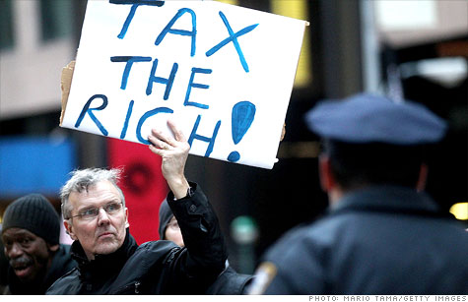




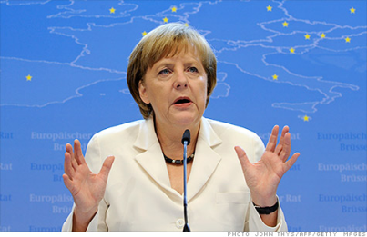

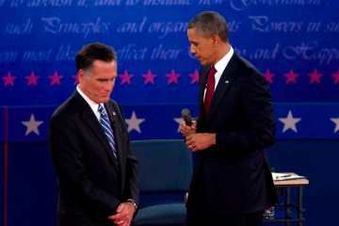



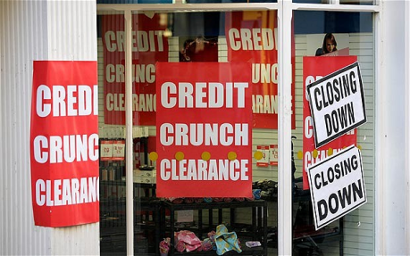


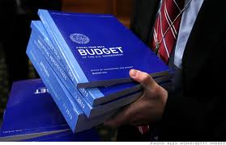
2012-13 Economic Headlines
Notes:
Herman Cain said it best in one of the Republican debates : Uncertainty is killing the economy
Let’s look some headlines for 2012-2013 – I mean its like a comedian made these up:
Debt Ceiling -
Taxation – either Warren Buffet or Bill Roberts
National Deficit – Now $16 Trillion
Fiscal Cliff or Cliffs as we are now learning – Becoming Cliff Dwellers or Divers?
Partisans – Sounds like a Humphrey Bogart Movie
Credit Crunch – store sale of cereal
Fiscal Stimulus – am sure this is something they are smoking in Oregon
Inflation / Deflation – which one is it???
Federal budget – or more like lack of budgeting…
It’s the economy or the environment – can’t it be both??
Bubble in China – yeah going from 9 to 6% GDP growth is a bubble!!!
Sovereign Debt – guess that is the same thing as our “National Debt”
Angela Merkel – She should be praying
Double Dip recession – Let’s just tell our politicians “no double dipping”
The breakup of the Eurozone – Break up or stay together, just get on with it – and please change your ugly logo while you are at it…

Slide 3
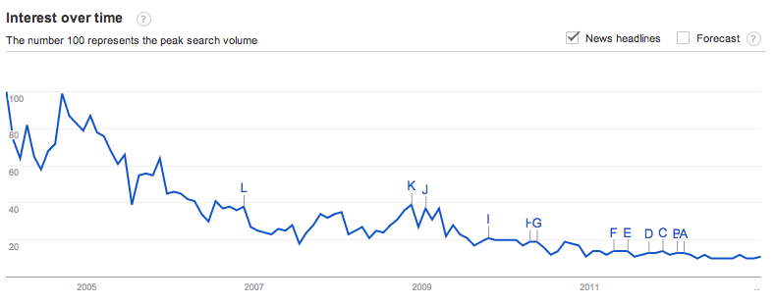
Google Searches for ‘Economic Forecasts’
2013

Slide 4
Perspective - Top 10 Google Searches for 2012
Top 10 Worldwide | Top 10 USA
1. Whitney Houston | 1. Whitney Houston
2. Gangnam Style | 2. Hurricane Sandy
3. Hurricane Sandy | 3. 2012 US Election
4. iPad 3 | 4. Hunger Games
5. Diablo 3* | 5. Jeremy Lin*
6. Kate Middleton | 6. Olympics 2012
7. Olympics 2012 | 7. Amanda Todd
8. Amanda Todd* | 8. Gangnam Style
9. Michael Clarke Duncan* | 9. Michael Clarke Duncan
10 BBB 12* | 10. KONY 2012*
Source: http://www.google.com/zeitgeist/2012/#the-world
Notes:
Diablo 3 – Video Game
Amanda Todd – Cyber bullying resulting in teen death
Michael Clarke Duncan – African American Actor died – Green Mile
BBB12 – Reality show, Android App, or lightweight aluminum bicycle bell
Jeremy Lin – Plays guard for the Houston rockets

Slide 5
Speakers & Agenda
EMEA – Dr. Lee Elliott
Head of EMEA Research, Jones Lang LaSalle
APAC – Mr. Hans Vrensen
Global Head of Research, DTZ
Americas – Ms. Brook Scott
Head of Americas Occupier Research, CBRE
San Francisco Bay Area – Ms. Maria Sicola
Executive Managing Director of Research, Cushman & Wakefield
Moderator – Mr. Sven Pole
Executive Vice President, Global Corporate Services, CBRE

Slide 6
Format of Presentations
Macroeconomic Indicators By Region
Labor Market Outlook By Region
Commercial Office Markets
Supply/Demand
Vacancy vs. Net Absorption
Rental Rates
Market Cycles
Market Strategies & Opportunities
Key Trends in 2013

Slide 7
Europe, Middle East, Africa
Dr. Lee Elliott - Head of EMEA Research, Jones Lang LaSalle

Slide 8
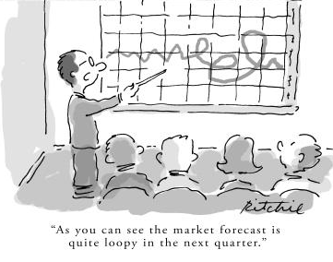

Macro Economic Indicators By Region

Slide 9
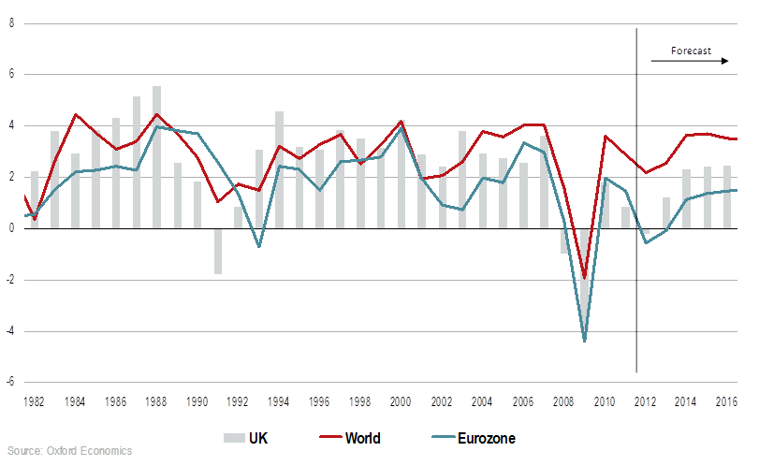
Macro Economic Indicators By Region
GDP % YoY 1981-2016

Slide 10
Macro Economic Indicators By Region
0.7%
GDP Growth Forecast 2013
< 0%
2.0%
0.0 – 0.9%
1.1%
3.4%
1.0 – 1.9%
1.0%
2.0 – 2.9%
1.0%
> 3.0%
1.2%
0.4%
0.5%
2.4%
1.0%
0.8%
0.5%
0.8%
-0.5%
1.8%
-2.0%
-2.0%
2.5%
4.2%
-3.4%
Source: Consensus Economics, October 2012

Slide 11



Macro Economic Indicators By Region
Plus ça change – Eurozone crisis is still key threat Some improvements, but underlying problems remain
Sudden recovery (10%)
Muddling along (60%)
Disorderly deterioration (30%)
(but nightmare case <10%)

Slide 12
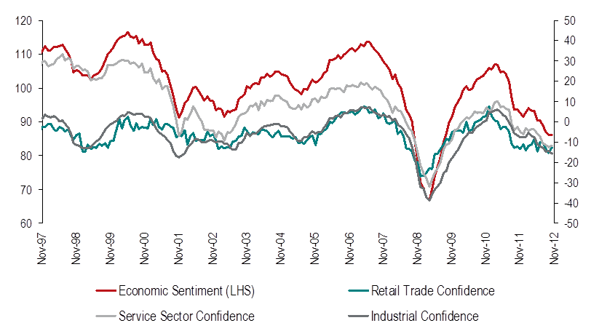
Labor Market Outlook By Region
Fragile corporate confidence persists
Source: European Commission, November 2012

Slide 13
Labor Market Outlook By Region

Slide 14
Office Markets – Supply / Demand
Net absorption positive but moderate through 2012
in ‘000 sq m
Source: Jones Lang LaSalle, October 2012

Slide 15
Office Market – Vacancy vs. Absorption
Completion volumes weak, forecast to improve but with downside risk

Slide 16
Office Market – Vacancy vs. Absorption
Q3 2012 (%)
Q4 2014 (%)
Europe 9.7%
Europe 9.5%
Source: Jones Lang LaSalle, October 2012

Slide 17
Office Market – Rental Rates
Prime Rents & Effective Rents 2012 Q3
Rent
US$/ ft² pa
% = Average Incentives as % of Prime Rent
Source: Jones Lang LaSalle IP, October 2012

Slide 18
Office Market – Rental Rates
Amsterdam, Eindhoven, Geneva, Rotterdam, The Hague, Utrecht
Paris CBD, London West End
Zurich
Western Europe
Central and Eastern Europe
Middle East and Africa
Helsinki, London City
Oslo, Stuttgart, Rabat
Milan
Tel Aviv
Berlin, Cologne, Lyon, Casablanca
Warsaw
Rental Growth
Slowing
Rents
Falling
Stockholm, Düsseldorf, Moscow
Hamburg
Copenhagen
Munich
Algiers
Rental Growth
Accelerating
Rents Bottoming Out
Gothenburg
Southampton, Liverpool
Krakow
Kuwait City, Zagreb
Abu Dhabi, Doha, Muscat, Riyadh
Johannesburg, Luxembourg
Antwerp, Athens, Nottingham, Jeddah, Cairo, Manama
Lisbon, Newcastle, Rome, Belgrade
Western Corridor
Budapest, Madrid
Manchester
Barcelona, Brussels, Dublin, Tunis
Birmingham, Bristol, Cardiff, Edinburgh,
Frankfurt, Glasgow, Leeds, Malmo,
Istanbul, Dubai, Kiev, Tri-City, Bucharest,
Bratislava, Prague
Source: Jones Lang LaSalle IP, October 2012

Slide 19






Office Market – Market Cycles
 | 2013 | 2014 | 2015
Amsterdam
Dublin
Frankfurt
London City
London West End
Madrid
Milan
Moscow
Paris CBD
Prague
Stockholm
Warsaw
Tenant Favourable Market Conditions
Balanced Market Conditions
Landlord Favourable Market Conditions

Slide 20

Market Strategies & Opportunities
Raising the productivity of people and places as well as managing cost
Leveraging technology and analytics to enhance decision making / strategy
Securing scarce investment capital from within the business
Attracting and retaining talent
Managing mobility – functional and worker mobility

Slide 21
Key Trends in 2013
Operating Environment
Confidence to steadily rebuild over H1. Selective strategic investment in H2 including M&A
CRE Agenda
Enhancing productive through transformation. Selective platform building esp Africa
Competition
Moderate though improving in H2 and tipping market conditions away from occupiers
Choice
Polarised supply side with acute lack of transformative space and no respite from the pipeline
Cost
1st movers protected from significant rental uplifts. Laggards hit hard. It’s about more than rents

Slide 22
Asia Pacific
Mr. Hans Vrensen - Global Head of Research, DTZ

Slide 23
Contents
Global economic overview
Asia Pacific market update
Downside scenario analysis
Conclusions

Slide 24
Asia Pacific keeps going, but mind the range
Average GDP and employment growth by country
Source: Oxford Economics

Slide 25
Probability of multiple EU exit at highest level ever
Estimated scenario probabilities
Source: Oxford Economics

Slide 26
Downside scenario will have lasting impact on all regions
Average GDP growth 2013-17
Source: Oxford Economics

Slide 27
Low government bonds yields mean low hurdle rate for property
Selected government bond yields
Italy
Italy
US
US
Japan
Source: Oxford Economics

Slide 28
Risk appetite remains strong for corporate bond yields
Composite corporate bond yields
Source: Bloomberg

Slide 29
Cost savings across the board in downside scenario
Regional prime rental growth, base case and scenarios, (2013-14 pa)
Source: DTZ Research

Slide 30
Contents
Global economic overview
Asia Pacific market update
Downside scenario analysis
Conclusions

Slide 31
Strong rental growth in many developing markets
DTZ Rental wave APAC
Source: DTZ Research

Slide 32
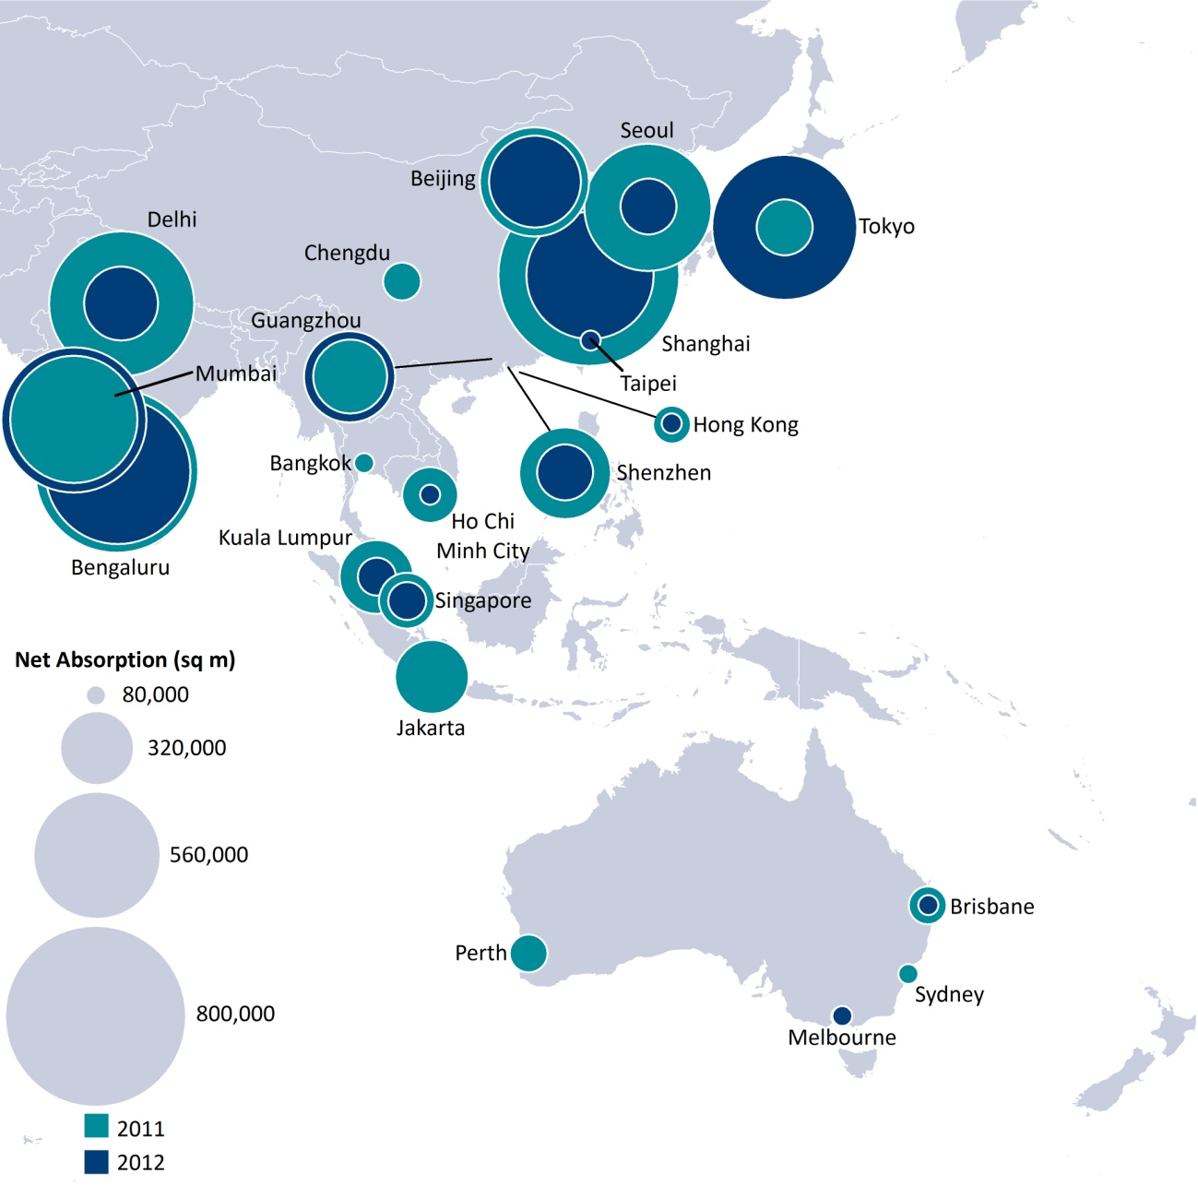
Office demand remains strong in the majority of markets
Absolute net absorption in 2011 and 2012

Slide 33
Asia Pacific the only region with above inflation growth in occupancy costs
Growth in total occupancy costs per workstation 2011-2012 (in USD)
Source: DTZ Research/Oxford Economics

Slide 34
Contents
Global economic overview
Asia Pacific market update
Downside scenario analysis
Conclusions

Slide 35
Asia Pacific well placed to deal with negative impacts of Euro breakup
Annualised GDP growth 2013-2017
Source: DTZ Research

Slide 36
Downside scenario chart on Asia Pacific office rents
Annualised rental growth 2013-17
Source: DTZ Research

Slide 37
Where downside offers opportunities?
Annualised change in occupancy costs (2012-2014)
Source: DTZ Research

Slide 38
Contents
Global economic overview
Asia Pacific market update
Downside scenario analysis
Conclusions

Slide 39
Key views for 2013
The probability of multiple Eurozone exits is higher than ever, despite this we think that property market risks have been over estimated by occupiers
Asia Pacific occupiers are expected to benefit from more affordable occupancy per workstation costs compared to western markets
Indian and second tier Chinese markets will remain amongst the most affordable markets in the region, despite forecasts rental growth coming

Slide 40
Americas
Ms. Brook Scott - Head of Americas Occupier Research, CBRE

Slide 41
Macro Economic Indicators By Region
(Real GDP, Annual % Change)
Source: IHS Global Insight, December 2012

Slide 42
U.S. Labor Market Outlook
Source: IHS Global Insight, December 2012

Slide 43
Canadian Labor Market Outlook
Source: IHS Global Insight, December 2012

Slide 44
Latin American Economic Outlook
Source: IHS Global Insight, December 2012

Slide 45
US Office Market – Supply / Demand
(SF x 1000)
(Vacancy Rate)
Source: CBRE EA, Q3 2012

Slide 46
Canada Office Market – Supply / Demand
(SF x 1000)
(Vacancy Rate)
Source: CBRE Research, Q3 2012.

Slide 47
Latin America Office Market – Supply/Demand
(SF x 1000)
(Vacancy Rate)
Source: CBRE Research, Q3 2012.

Slide 48
Prime Office Occupancy Costs
(US$/sq. ft./annum)
Source: CBRE Research, Q3 2012.

Slide 49
Largest Annual Prime Occupancy Cost Increases
(Annual Percent Change, Americas (Q3 2012)
Source: CBRE Research, Q3 2012.

Slide 50
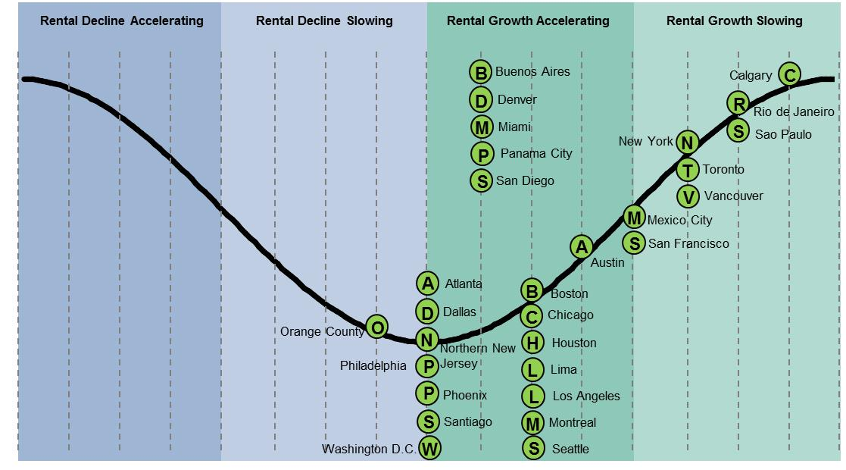
Americas Office Rent Cycle
Source: CBRE Research, Q3 2012.

Slide 51
Market Strategies & Opportunities
Continued focus on reducing overall office footprint
Emphasis on collaborative space
Use of amenities to attract and retain workers
Importance of tech-enabled space
Sustainability focus: “healthy” building materials

Slide 52
Key Trends in 2013
Fate of North American office markets inextricably tied to political outcomes
Fewer opportunities to negotiate favorable lease terms
Accelerating rent growth – Downtown
Focus on workplace strategies

Slide 53
San Francisco Bay Area
Ms. Maria Sicola - Executive Managing Director of Research,
Cushman & Wakefield

Slide 54
Macro Economic Indicators By Region
Bay Area is the Epicenter of Technology
Since the late 1950s (founding of Fairchild Semiconductor) through 2012 (Facebook now has one billion active users)
The West Coast Business Center for Traditional Industries
Finance and law
Highly Skilled and Educated Workforce
Large concentration of research labs and top universities in the world (Stanford, UC Berkeley, Santa Clara)
Highly educated workforce
Job recovery outpacing nation
Largest amount of venture capital invested in the U.S.
Housing Stabilizing
Quality of life
Great cultural institutions, entertainment venues, restaurants
Natural setting

Slide 55
Macro Economic Indicators
VENTURE CAPITAL FUELS LEASING
Total Invested: | $2.6 billion
Total # of Deals | 268 deals
% Breakdown by Industry
Software | 43.6%
IT Services | 13.9%
Biotechnology | 12.1%
Computers & Peripherals | 5.8%
Media and Entertainment | 5.3%
Semiconductors | 3.5%
Financial Services | 3.0%
Other | 12.8%
SOURCE: : PRICEWATERHOUSECOOPERS MONEY TREE REPORT, THIRD QUARTER 2012

Slide 56
Labor Market Outlook
139.5%
Note: US Trough=February 2010
San Francisco Trough=February 2010
99.4%
20.4%
3.6%
SOURCE: US BUREAU OF LABOR STATISTICS

Slide 57
Labor Market Outlook By Industry Sector
SAN FRANCISCO
OAKLAND
Total Change +63,800
Total Change 20,200
SILICON VALLEY
Total Change +72,500
SOURCE: US BUREAU OF LABOR STATISTICS

Slide 58
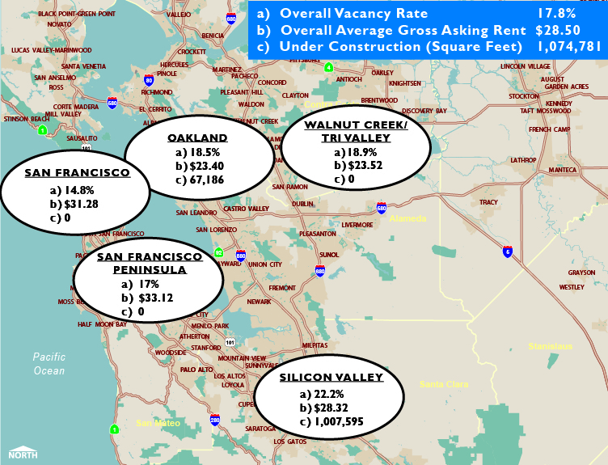
Office Markets: Bay Area – Q4 2009

Slide 59
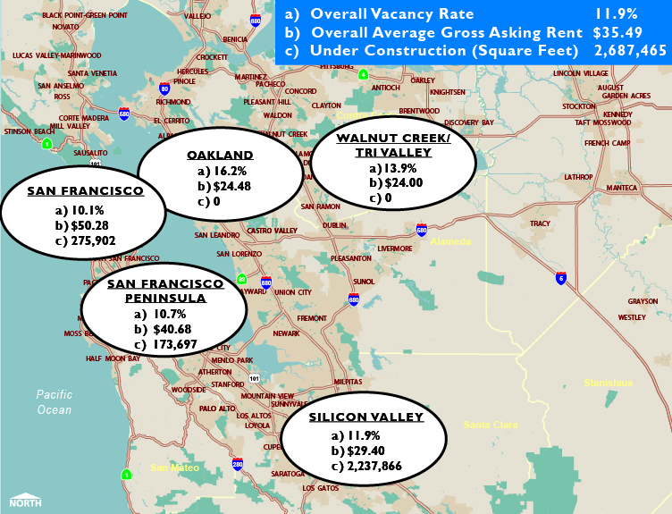
Office Markets: Bay Area – Q4 2012

Slide 60
San Francisco Office Market – Current Tenant Demand
By Industry Sector
4,565,000 Square Feet of Total Active Tenant Requirements
Notes:
Updated by crg 3/30/12

Slide 61
San Francisco Office Market – Rent Comparisons
Q2 2012
 | Q4 | Q4 | YoY
 | 2011 | 2012 | Growth (%)
Tech Index | $49.26 | $51.89 | 5.3%
“Class A Tech” | $50.70 | $52.83 | 4.2%
“Prime Creative Tech” | $44.16 | $50.14 | 13.5%
TECH INDEX: tracks a distinct set of buildings that have the highest concentration of tech firms in San Francisco. While this index does not include all buildings occupied by tech users, it does differentiate between “Class A Tech” buildings and “Prime Creative Tech.”
“PRIME CREATIVE” space, defined as historic and/or brick & timber construction that has undergone a major retrofit within the past 15 yrs, currently consists of 37 buildings with a total inventory of 4.5 msf.
“CLASS A TECH” is defined as traditional class A, mid- and low-rise office space that has been modified to accommodate technology and creative users in a non-traditional office environment. Features often include design elements such as exposed ceilings and duct-work and indirect lighting.

Slide 62
San Francisco Office - Vacancy Rate Vs. Rental Rates
FORECAST
SOURCE: CUSHMAN & WAKEFIELD RESEARCH

Slide 63
Silicon Valley Office - Vacancy Rate Vs. Rental Rates
FORECAST
SOURCE: CUSHMAN & WAKEFIELD RESEARCH

Slide 64
US CBD Office Rent Cycles
(Q3 2012)
Slow Growth
Accelerating
San Francisco
Midtown South
LANDLORD FAVORABLE
Boston
Houston
Midtown Manhattan
Downtown NY
Washington DC
New Haven
Denver
Hartford, Tampa
Chicago
Orlando, Ft. Lauderdale
Portland
TENANT FAVORABLE
Orange County, Jacksonville
Dallas, Fairfield County
Palm Beach
Westchester County
Downturn
Atlanta, Baltimore
San Diego, Los Angeles, Miami, Sacramento
Oakland
Recovering
Rent still elevated but falling from top of market cycle. Falling rents promise future opportunity for tenants
Rent growth accelerating
Ideal for owners of property
Rent at or near bottom of market cycle. Ideal for tenants leasing or seeking to lease property
Rent growth slowing. Still landlord favorable but growth is down from peak
SOURCE: CUSHMAN & WAKEFIELD RESEARCH

Slide 65
US Suburban Office Rent Cycles
(Q3 2012)
Slow Growth
Accelerating
San Francisco
LANDLORD FAVORABLE
Silicon Valley
Baltimore
San Francisco Peninsula
Northern VA
Suburban MD
Houston
St. Petersburg
Denver
Westchester County
Long Island, Hartford
New Haven, Boston
Fairfield County
Chicago, Philadelphia
TENANT FAVORABLE
Orange County
Ft. Lauderdale
Jacksonville, Miami, Sacramento
Los Angeles, Contra Costa
Phoenix, San Diego, Tampa
Palm Beach, Central NJ
Downturn
San Diego, Southern NH
Recovering
Northern NJ, Orlando, Atlanta
Oakland, Inland Empire, Dallas, Portland
Rent still elevated but falling from top of market cycle. Falling rents promise future opportunity for tenants
Rent growth accelerating
Ideal for owners of property
Rent at or near bottom of market cycle. Ideal for tenants leasing or seeking to lease property
Rent growth slowing. Still landlord favorable but growth is down from peak
SOURCE: CUSHMAN & WAKEFIELD RESEARCH

Slide 66

Key Trends in 2013
Tech will continue to dominate job growth
Firms maintain a strong presence in San Francisco
Traditional users may move some operations to lower-cost suburban markets, but will keep headquarters in San Francisco
Construction pipeline ramping up across major markets; Much of this space is pre-leased
Office construction increasing in Silicon Valley and going vertical

Slide 67

Market Strategies & Opportunities
San Francisco and Silicon Valley will remain a tech “hot spot” given high concentration of talent, firms and venture capital.
Act now – this could last another 36 months
Outdated real estate will be replaced with newer, more efficient space.
Renovations will continue in San Francisco
New construction in Silicon Valley will replace old/tired space
It’s what is inside that counts
Interior design
Flexibility in workplace strategies

Slide 68
Panel Discussion – Q&A
Mr. Sven Pole - Executive Vice President, Global Corporate Services, CBRE

Slide 69
2013 Annual Market Forecast
Global Market Forecast & Outlook
Electronic Arts HQ, Redwood City, CA
17 January 2013

